Slide 1

Final Project Presentation
DS105

Slide 2
Agenda
Problem Statement
Dataset
EDA
Final Database (preparation to fit into machine learning model)
Feature column, label and baseline modelling
Hyper-parameter tuning (Gridsearchcv)
Model Selection
Key learnings

Slide 3
1. Problem Statement
To create a machine learning model to predict and reduce customer churn.
I will explore classification model such as KNN, Random Forest, Gradient Boosting, Logistic Regression, Adaboost and other classification models
I chose classification model as compared to regression model as the final output is to determine if the customer will churn or not (Yes/No Classification) instead of prediction of future values (E.g. the price of house in 2 to 10 years time, the predicted sales in 6 to 12 months

Slide 4
2. Dataset
BankChurners.csv
Source : https://www.kaggle.com/sakshigoyal7/credit-card-customers

Slide 5
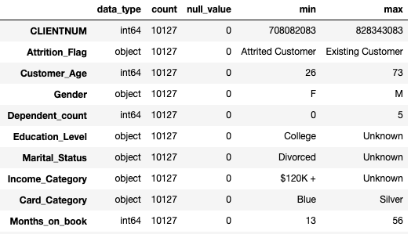
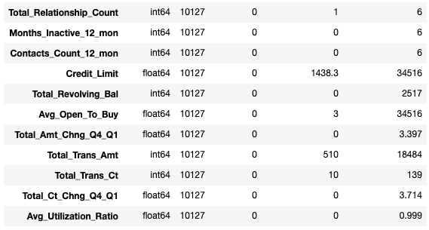
Dataset - Overview
This dataset contains 21 columns and 10,127 rows. Overall the dataset is very clean. Overview as attached
Purple Box is the target.

Slide 6
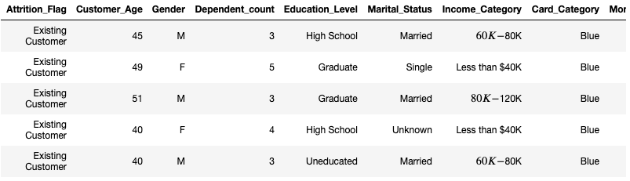
Dataset - cont
A snapshot of the dataset

Slide 7
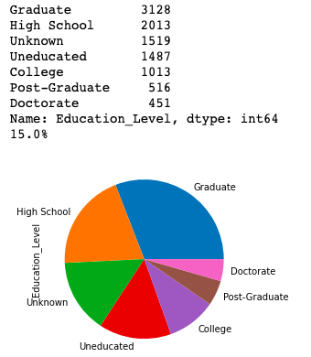
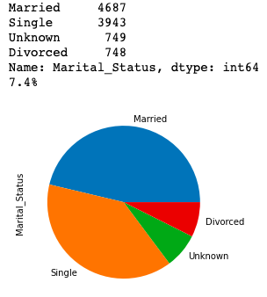
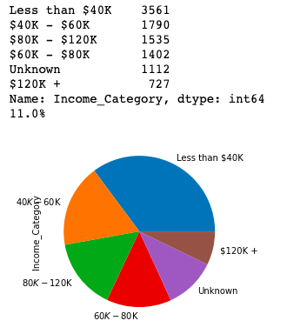
3 - EDA
Treatment of unknown values
Education_level column have 1519 unknown which represents 15% of the data
Marital_Status column have 749 unknown which represents 7.4% of the data
Income Category column have 1112 unknown which represents 11% of the data

Slide 8
EDA : Treatment of unknown values
After much considerations, I will treat unknown as a classification by itself as it may be overly generalise if I were to use the ”mode” in each category. Also, the customer probably intentionally leave out the information and it may also have impact on how genuine they are and how likely someone where to churn if they intentionally leave out certain information.

Slide 9
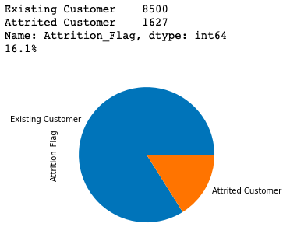
EDA : Imbalance class
Imbalance class
For the target data, 16.1% of the dataset is churned customer whereas 83.9% of the dataset is existing customer. I will use, stratify and weight adjusting techniques.

Slide 10
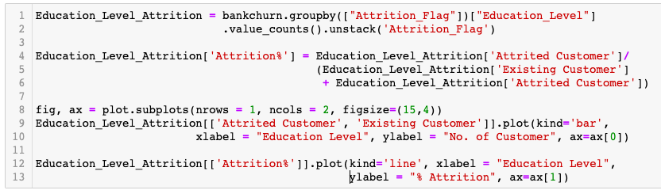
EDA – Important Features Method

Slide 11
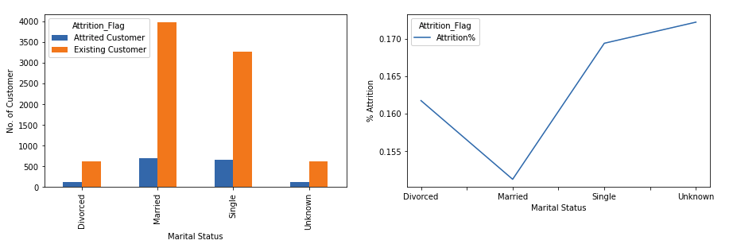
EDA – Important Features Marital Status
Married customer out-performs
Unknown category under-perform

Slide 12
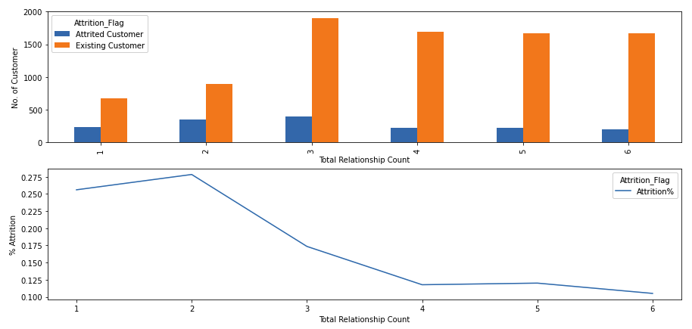
EDA – Important Features Relationship with Bank
Customer is less likely to attrite when they have 3 or more product
Bank to try to do more cross selling (> 3 product)

Slide 13
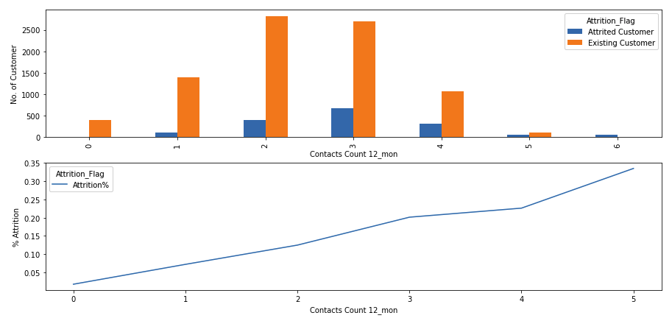
EDA – Important Features Contact Count in Last 12 Months
The more contact, the likely the attrition (Could be complains)
Bank to investigate further on the topic/discussion of the contacts

Slide 14
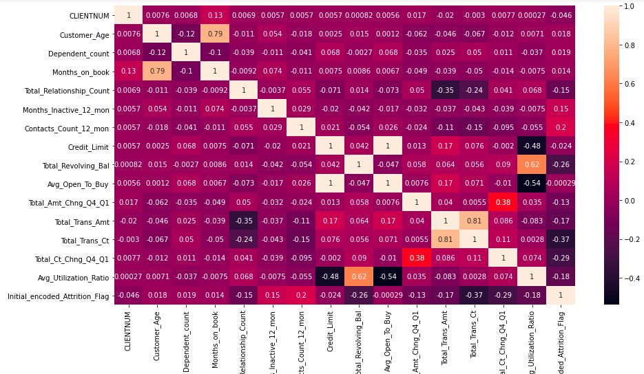
EDA – Important Features Correlation

Slide 15
EDA – Important Features Other insights
Visible Trends
Income group – Middle income group is the most loyal
Gender – Male have a lower attrition (Data is even)
No Visible Trends
Client number (To remove)
Age (To keep)
Card Category (To keep)
Months on Book (To keep)

Slide 16
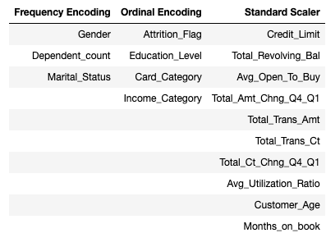
EDA : Encoding
Prevent multi-dimensional issues by using Frequency Encoding, Ordinal Encoding and Standard Scaler

Slide 17
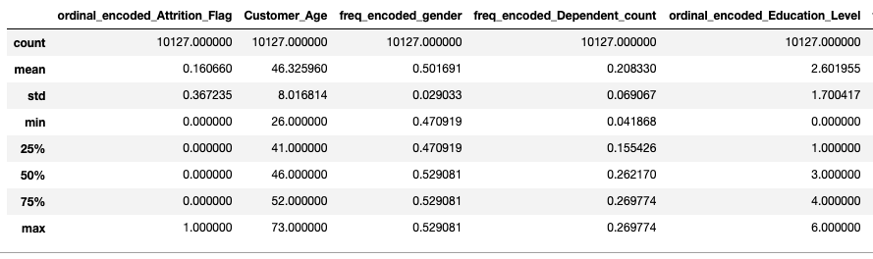
4. Database for Machine Learning (Interim)

Slide 18
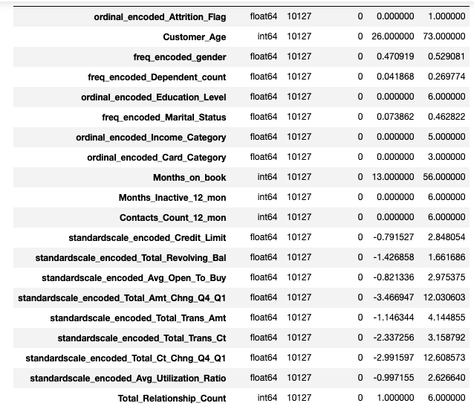
4. Database for Machine Learning (Interim)

Slide 19
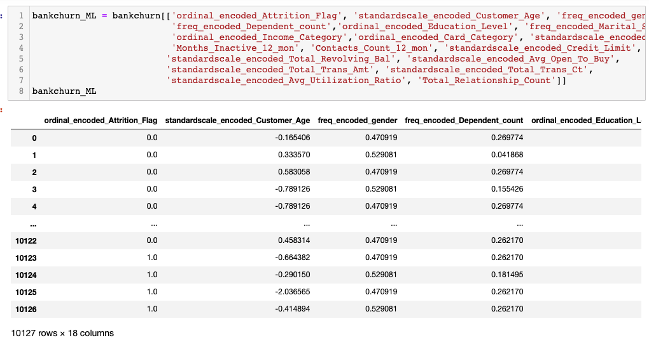
4. Database for Machine Learning (Final)

Slide 20
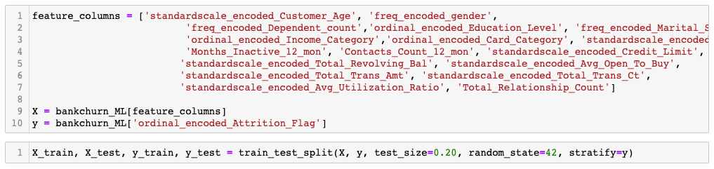
5. Feature column and Label

Slide 21
5. Testing of baseline model
KNN (K nearest neighbour)
RF (Random forest)
LR (Logistic regression)
SVM (Support vector machine)
Gradient Boosting
Adaboost

Slide 22
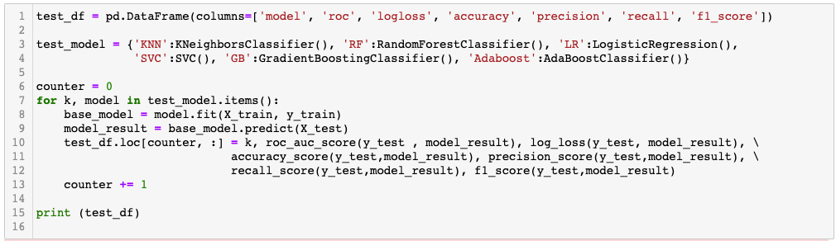
5. Testing of baseline model

Slide 23
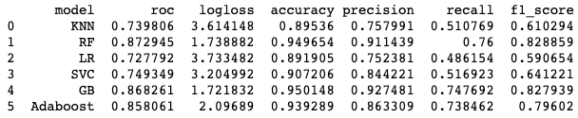
5. Testing of baseline model

Slide 24
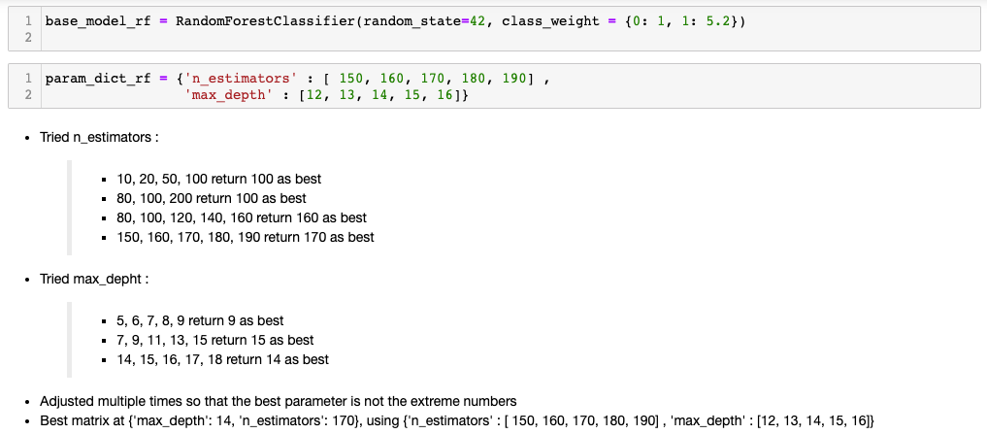
6. Hyper-parameter tuning Random Forest

Slide 25
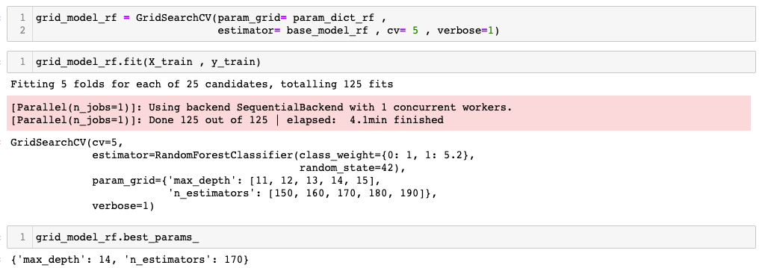
6. Hyper-parameter tuning Random Forest

Slide 26
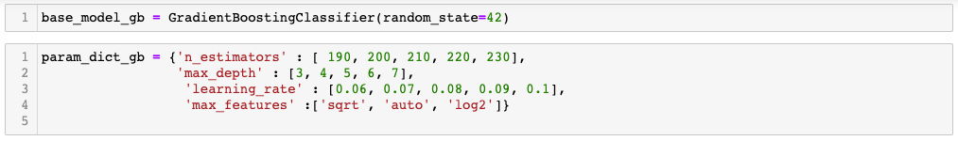
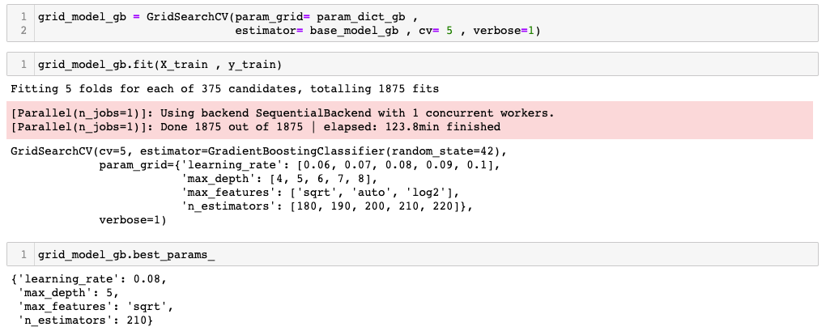
6. Hyper-parameter tuning Gradient Boosting

Slide 27
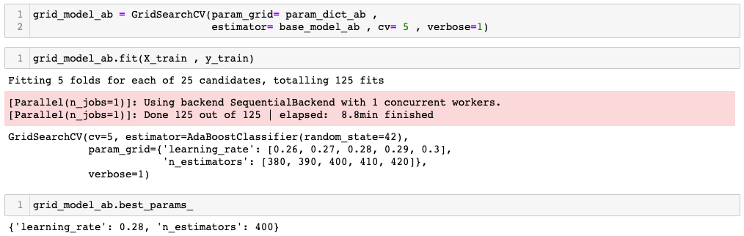
6. Hyper-parameter tuning

Slide 28
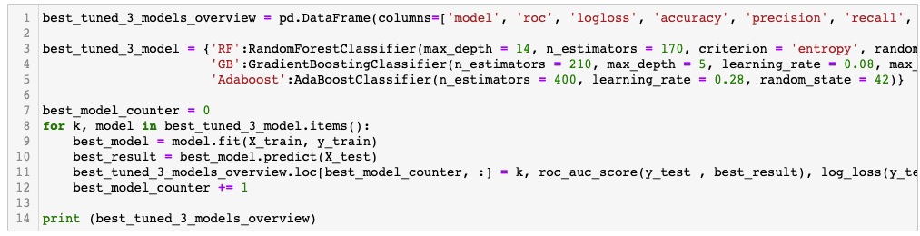
6. Hyper-parameter tuning

Slide 29

6. Hyper-parameter tuning

Slide 30
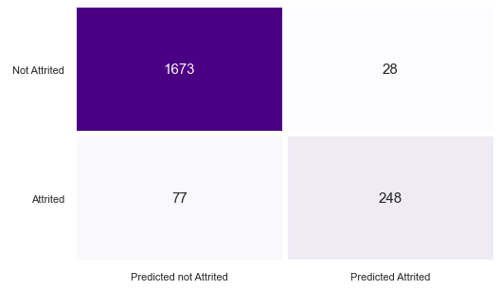
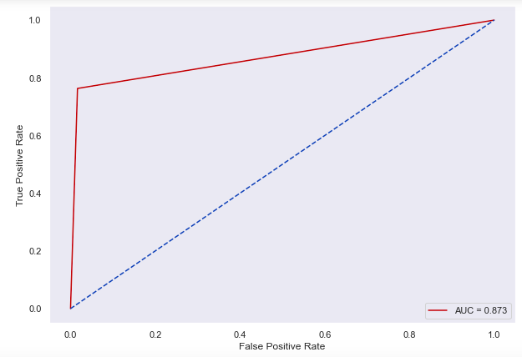
7. Model Selection
I select RandomForest model because the dataset that I am working on is unbalanced dataset (84% - 16%) and I can do weight adjustment on this model
The model is also very accurate with Logloss 1.722, ROC-AUC score at 0.879, accuracy at 0.95, precision at 0.91, recall at 0.775 and F1 score at 0.833

Slide 31
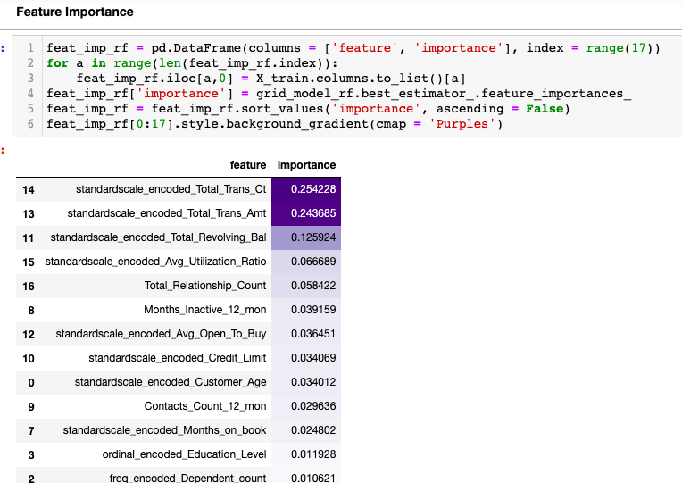
7. Model Selection

Slide 32
8. Key learnings
After EDA is completed, clean the codes, clear output and re-run before starting on machine learning
For Random forest tuning, start with a wider range and start to narrow the range towards the best fit instead of starting with low number and extend upwards
For tuning of gradient boosting, as it takes very long (>1hr), recommend to run 1 test to get the range, then expand into a more comprehensive list and let it run overnight

